Slide 1
DEEP LEARNING BASED BRAIN TUMOR DETECTION: A CNN APPROACH FOR ACCURATE MEDICAL IMAGING ANALYSIS
Presented by :
Ravi Kumar Gupta
23MCA1031
MCA:2023-2025
Under the Guidance of
Dr. Sridevi S
Imaging and Computer Vision

Slide 2
Table of contents
Introduction
Architecture Diagram of your Project work
1
5
Abstract
6
Dataset Description
2
3
Problem Statement /Research Objectives Identified
Guide Approval mail
8
Result
7
4
Literature review
Status of work to be completed
9

Slide 3
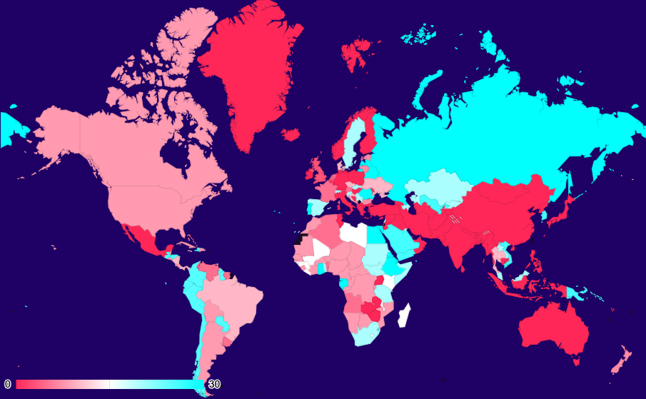
Disease prevalence
0-5% of the population in these regions are affected by the disease
6-14% of the population in these regions are affected by the disease
15-30% of the population in these regions are affected by the disease

Slide 4

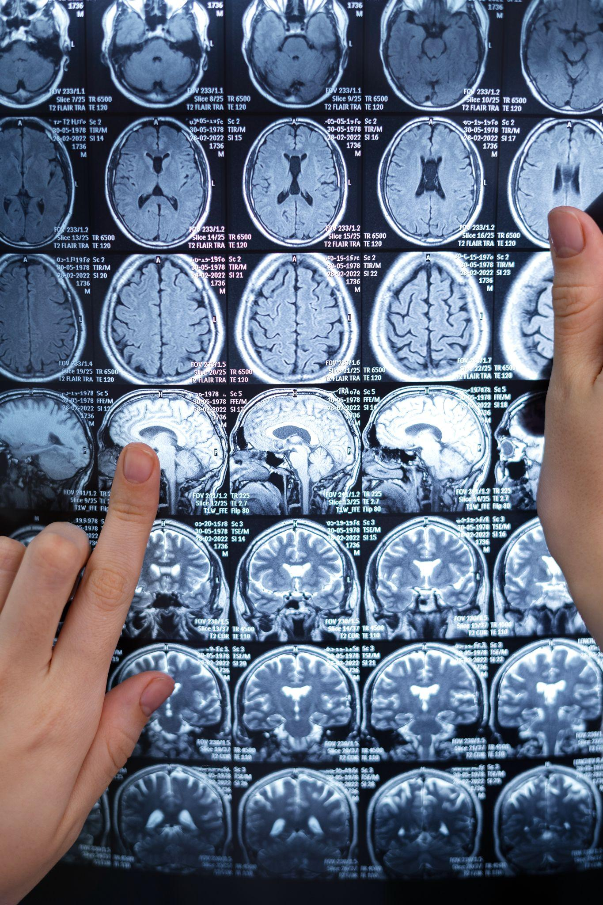
Introduction to the disease
Brain tumors pose significant health challenges, often necessitating complex diagnostics and prompt treatment. Traditional detection methods, such as manual examination of MRI scans, are time-consuming and susceptible to human error. The rise of advanced machine learning techniques has sparked interest in automating this process to enhance accuracy and efficiency.
Deep learning, particularly Convolutional Neural Networks (CNNs), has become a pivotal tool in medical imaging analysis. CNNs excel in image-based tasks due to their ability to learn hierarchical features directly from raw data, making them ideal for detecting subtle anomalies in medical images that may indicate tumors.
This project investigates the use of CNNs for brain tumor detection, aiming to develop a reliable model that classifies MRI scans into categories like healthy tissue, benign tumors, and malignant tumors. Automating this process can assist medical professionals in making quicker, more accurate diagnoses, thus improving patient outcomes.
The motivation for this work is the transformative potential of deep learning in medical diagnostics. By utilizing extensive datasets and advanced computational resources, CNNs offer a scalable solution for complex image analysis. This study aims to validate the efficacy of CNNs in brain tumor detection and contribute to the broader application of artificial intelligence in healthcare.

Slide 5
Abstract
Brain tumor detection is a critical task in medical diagnostics, requiring precise and timely identification for effective treatment. This work focuses on the application of deep learning techniques, specifically Convolutional Neural Networks (CNNs), for accurate analysis and detection of brain tumors from medical imaging data. The choice of CNNs stems from their proven ability to automatically extract relevant features and patterns from complex data, making them ideal for handling the intricacies of medical images . In this study, we employ a CNN-based model trained on a dataset of brain MRI scans. The model is designed to classify and identify different types of brain tumors, distinguishing between healthy and pathological tissues with high accuracy. The implementation involves preprocessing of the MRI scans, data augmentation to enhance model robustness, and careful tuning of the CNN architecture to optimize performance. This approach is chosen due to its potential to significantly improve diagnostic accuracy and reduce the workload on radiologists. By leveraging the power of deep learning, the proposed system aims to assist in early detection and diagnosis, ultimately contributing to better patient outcomes.

Slide 6
Problem Statement
Brain tumors are one of the most life-threatening medical conditions, requiring early and accurate detection for effective treatment. Traditional diagnostic methods, such as MRI and CT scans, rely heavily on expert interpretation, which can be time-consuming and prone to human error. This presents a significant challenge in resource-constrained environments where access to highly specialized radiologists is limited. Additionally, the variability in tumor size, shape, and location further complicates accurate detection.
The problem is to develop a deep learning-based approach utilizing Convolutional Neural Networks (CNNs) to automate the detection of brain tumors from medical imaging data.
The goal is to enhance diagnostic accuracy, reduce the time required for diagnosis, and provide a reliable tool that can assist radiologists, particularly in regions where expert medical personnel are scarce.
This approach must handle the inherent complexity and variability of brain tumor characteristics while ensuring high sensitivity and specificity in detecting various tumor types across diverse patient demographics.

Slide 7
Literature Review-1
Rezayi, S., Keshavarz, H., & R. Niakan Kalhori, S. (2023). MRI-based brain tumor detection using convolutional deep learning methods and chosen machine learning techniques. BMC Medical Informatics and Decision Making, 23(1), 16.
Start
Introduction
Dataset
Methodology
Result/Accuracy
The paper explores enhancing brain tumor detection and classification using advanced computational techniques, specifically deep learning and machine learning. It aimed to diagnose glioma, meningioma, pituitary gland tumors, and healthy brains from MRI images.
Utilizing a dataset of 3,264 MRI images, researchers preprocessed and augmented the data.
They developed a 2D Convolutional Neural Network (CNN) DCNET and a convolutional auto-encoder network, with the CNN achieving 96.47% training accuracy and the auto-encoder 95.63%. The CNN outperformed traditional methods, including K-Nearest Neighbors (KNN) and Multilayer Perceptron (MLP), demonstrating superior accuracy and efficiency, making it a valuable tool for clinicians.
CNN 96.47%
Auto encoder 95.63%
End

Slide 8
Literature Review-2
Liu, X., Bonner, E. R., Jiang, Z., Roth, H. R., Anwar, S. M., Packer, R. J., ... & Linguraru, M. G. (2023, April). Automatic segmentation of rare pediatric brain tumors using knowledge transfer from adult data. In 2023 IEEE 20th International Symposium on Biomedical Imaging (ISBI) (pp. 1-4). IEEE.
Start
Introduction
Dataset
Methodology
Result/Accuracy
This study addresses the challenge of segmenting Diffuse Midline Glioma (DMG), a rare and aggressive pediatric brain tumor, using deep learning models. Given the scarcity of pediatric DMG data, the authors explore a knowledge transfer approach by pretraining state-of-the-art segmentation models on a large adult glioblastoma multiforme (GBM) dataset (BraTS2021) and subsequently fine-tuning on pediatric DMG MRI scans.
The dataset comprises multisequence MRI scans from 45 children with DMG, totaling 82 scans across different timepoints
The models evaluated include SegResNet and nnU-Net, both with and without pretraining. The results demonstrate that pretraining significantly enhances segmentation performance, particularly with nnU-Net, which achieved Dice scores of 0.859 for the enhancing region and 0.880 for the whole tumor. Additionally, pretraining accelerates training convergence, making the process more computationally efficient.
nnU-Net 0.859%
End

Slide 9
Literature Review-3
Soomro, T. A., Zheng, L., Afifi, A. J., Ali, A., Soomro, S., Yin, M., & Gao, J. (2022). Image segmentation for MR brain tumor detection using machine learning: a review. IEEE Reviews in Biomedical Engineering, 16, 70-90.
Start
Introduction
Dataset
Methodology
Result/Accuracy
The paper reviews advancements in MRI-based brain tumor detection using machine learning, covering methods from 1996 to 2020. It analyzes traditional, machine learning, and deep learning models, highlighting that CNNs significantly improve segmentation accuracy, achieving up to 97.87%.
The dataset comprises multisequence MRI scans .
Traditional Methods: Thresholding, region-growing, contour-based.
Machine Learning Models: SVM, Fuzzy C-Means, K-means, Random Forest.
Deep Learning Models: CNNs, FCNNs, U-Net, Autoencoders, GANs.
Traditional methods showed limited accuracy. CNNs improved performance; some models achieved up to 97.87% accuracy. Multi-task learning models excelled in combining tasks.
End

Slide 10
Literature Review-4
Shah, H. A., Saeed, F., Yun, S., Park, J. H., Paul, A., & Kang, J. M. (2022). A robust approach for brain tumor detection in magnetic resonance images using finetuned efficientnet. Ieee Access, 10, 65426-65438.
Start
Introduction
Dataset
Methodology
Result/Accuracy
The paper "A Robust Approach for Brain Tumor Detection in Magnetic Resonance Images Using Finetuned EfficientNet" proposes an efficient method for detecting brain tumors in MRI scans, leveraging a fine-tuned EfficientNet-B0 model.
The dataset comprises multisequence MRI scans .
Primary model: EfficientNet-B0, fine-tuned with additional layers.
Comparison models: VGG16, ResNet50, InceptionV3, Xception, and InceptionResNetV2. Optimizer: Adam (learning rate 1 0 − 3 10 −3 ).
Loss function: Binary cross-entropy for classification
Accuracy: Fine-tuned EfficientNet-B0 achieved 98.87% accuracy. Comparison results: VGG16 at 98.64% and InceptionV3 at 97.5%.
The EfficientNet-B0 model demonstrated high precision, recall, and AUC (Area Under the Curve). Effective tumor detection with minimal cost
End

Slide 11
Literature Review-5
Ahmad, S., & Choudhury, P. K. (2022). On the performance of deep transfer learning networks for brain tumor detection using MR images. IEEE Access, 10, 59099-59114.
Start
Introduction
Dataset
Methodology
Result/Accuracy
The paper "On Performance of Deep Transfer Learning Networks for Brain Tumor Detection" investigates various deep learning models for detecting brain tumors from 2D MRI images using transfer learning and traditional classifiers.
MRI brain images labeled as either normal or abnormal awere used. Data augmentation techniques were applied, and a 10-fold cross-validation approach was employed to evaluate the models.
Transfer Learning Models: Seven pre-trained CNN models were used as feature extractors: VGG-16, VGG-19, ResNet50, InceptionResNetV2, InceptionV3, Xception, and DenseNet201.The seven CNNs used transfer learning as feature extractors and were followed by traditional classifiers to detect brain tumors. Each combination was tested for performance. VGG-19 combined with SVM emerged as the best performing model among all tested combinations
The highest accuracy achieved was 99.39% with the VGG-19 and SVM combination. Other top-performing models included VGG-16 with SVM (99.31%) and ResNet50 with SVM (99.22%).
End

Slide 12
Literature Review-6
Bibi, N., Wahid, F., Ali, S., Ma, Y., Abbasi, I. A., & Alkhayyat, A. (2024). A Transfer Learning based approach for Brain Tumor Classification. IEEE Access.
Start
Introduction
Dataset
Methodology
Result/Accuracy
The paper addresses the challenge of accurately diagnosing and classifying brain tumors using machine learning (ML) techniques, emphasizing the importance of precise diagnosis for improving patient outcomes.
The study uses a comprehensive dataset of 7,022 MRI images sourced from various platforms
The authors propose a Transfer Learning approach utilizing the InceptionV4 neural network architecture. Key aspects of the methodology include.
Challenges Addressed: The paper tackles issues such as data scarcity, overfitting, and computational complexity associated with conventional neural networks by leveraging
The proposed InceptionV4 model achieves an impressive classification accuracy of 98.7%, indicating a significant advancement in brain tumor detection and classification capabilities.
End

Slide 13
Literature Review-7
Rajendran, S., Rajagopal, S. K., Thanarajan, T., Shankar, K., Kumar, S., Alsubaie, N. M., ... & Mostafa, S. M. (2023). Automated segmentation of brain tumor MRI images using deep learning. IEEE Access, 11, 64758-64768
Start
Introduction
Dataset
Methodology
Result/Accuracy
The paper addresses the automatic segmentation of brain tumors in MRI images, which is crucial for monitoring and treatment. Gliomas, being diverse and aggressive, require precise intra-tumoral classification for effective management.
The dataset comprises multisequence MRI scans .
The proposed method utilizes a combination of Gray Level Co-occurrence Matrix (GLCM) for feature extraction and two neural network architectures: U-Net and a Three-Dimensional Convolutional Neural Network (3D CNN). The technique involves: Feature extraction via GLCM to remove unnecessary details from MRI images. Combining predictions from the two networks to enhance segmentation accuracy.
Mean Accuracy: 99.40% for whole tumors, 98.46% for enhanced tumors, and 98.29% for tumor cores.
Precision: 99.41%, 98.51%, and 98.35% for the respective tumor types.
F-Score: 99.40%, 98.29%, and 98.46%.
Sensitivity: 99.39%, 98.41%, and 98.25%.
End

Slide 14
Literature Review-8
Subramanian, M., Cho, J., Sathishkumar, V. E., & Naren, O. S. (2023). Multiple types of cancer classification using CT/MRI images based on learning without forgetting powered deep learning models. IEEE Access, 11, 10336-10354.
Start
Introduction
Dataset
Methodology
Result/Accuracy
This paper focuses on classifying multiple types of cancer using CT and MRI images through advanced deep learning techniques, particularly leveraging Learning without Forgetting (LwF) and various convolutional neural network (CNN) architectures.
The dataset comprises multisequence MRI scans .
Evaluated five CNN architectures: VGG16, VGG19, DenseNet201, MobileNetV3 (Small), and MobileNetV3 (Large).
Accuracy The models were evaluated using metrics such as accuracy, precision, recall, and F1-score across multiple cancer types. Specific performance metrics were calculated for each of the thirteen classes within four cancer types, demonstrating the models' effectiveness in classification tasks
End

Slide 15
Literature Review-9
Shukla, G. P., Kumar, S., Pandey, S. K., Agarwal, R., Varshney, N., & Kumar, A. (2023). Diagnosis and detection of Alzheimer's disease using learning algorithm. Big Data Mining and Analytics, 6(4), 504-512.
Start
Introduction
Dataset
Methodology
Result/Accuracy
The study addresses the challenges of diagnosing Alzheimer's Disease (AD) and brain tumors through imaging techniques like MRI, PET, and CT scans. The paper highlights the need for improved classification methods to assist in the early diagnosis of AD, especially given its high prevalence among the elderly.
The dataset comprises multisequence MRI scans .
Image Pre-processing: Images were converted from 4D to 2D format, clipped for unnecessary borders, converted to grayscale, and enhanced through histogram equalization. Generative Adversarial Networks (GANs) were also used for synthetic image generation.
Classification Algorithms: The study proposed three algorithms: Random Forest, XGBoost, and Convolutional Neural Networks (CNN). Each algorithm was trained and evaluated post-pre-processing
Random Forest accuracy increased from 82.80% to 86.93%
XGBoost accuracy increased from 90.11% to 92.85%
CNN achieved an accuracy of 97.59%, up from 95.14%.
End

Slide 16
Literature Review-10
Khan, P., Kader, M. F., Islam, S. R., Rahman, A. B., Kamal, M. S., Toha, M. U., & Kwak, K. S. (2021). Machine learning and deep learning approaches for brain disease diagnosis: principles and recent advances. Ieee Access, 9, 37622-37655.
Start
Introduction
Dataset
Methodology
Result/Accuracy
The study reviews machine learning (ML) and deep learning (DL) approaches for diagnosing four major brain diseases: Alzheimer’s disease, brain tumors, epilepsy, and Parkinson’s disease. It emphasizes the importance of early detection for effective treatment.
The dataset comprises multisequence MRI scans .
Articles sourced from IEEE Xplore and ScienceDirect, focusing on ML and DL for specified diseases. Classification Algorithms: Utilized ML classifiers (SVM, Random Forest, KNN) and DL methods (CNN, RNN), emphasizing DL's strengths in feature extraction.
Reported accuracies up to 92%, with variations across different studies
End

Slide 17
Literature Review-11
Pries, T. P., Jahan, R., & Suman, P. (2018, September). Review of brain tumor segmentation, detection and classification algorithms in fmri images. In 2018 (CCTES) (pp. 300-303). IEEE.
Start
Introduction
Dataset
Methodology
Result/Accuracy
The paper reviews and summarizes machine learning approaches for brain tumor detection, focusing on segmentation, detection, and classification techniques used in MRI and fMRI scans.
The paper does not specify a single dataset but mentions the use of various MRI and fMRI scans from different sources across the studies reviewed.
Segmentation : Fuzzy C Means , Adaptive K-means Multi-Kernel Learning (MKL-SVM), and threshold-based methods.
Detection and Classification: Support Vector Machines (SVM), Convolutional Neural Networks (CNN), Artificial Neural Networks (ANN), Genetic Algorithms, Naïve Bayes Classifiers, and various combinations of these with feature extraction methods like Gray Level Co-occurrence Matrix (GLCM) and Wavelet Transform.
Segmentation : Accuracy ranges from 74.6% to 98.30%.
Detection and Classification: Methods achieve accuracies between 75.51% and 99%, with some techniques reaching over 97% accuracy.
End

Slide 18
Literature Review-12
Ezhilarasi, R., & Varalakshmi, P. (2018, August). Tumor detection in the brain using faster R-CNN. In 2018 2nd on I-SMAC (IoT in Social, Mobile, Analytics and Cloud)(I-SMAC) I-SMAC (IoT in Social, Mobile, Analytics and Cloud)(I-SMAC), 2018 IEEE.
Start
Introduction
Dataset
Methodology
Result/Accuracy
The paper proposes a system for detecting and classifying brain tumors using advanced image processing techniques. Here's a summary.
The goal is to detect brain tumors at an early stage and classify them accurately. The system uses MRI images of the brain for this purpose.
The dataset comprises multisequence MRI scans .
AlexNet: Used as the base model for tumor classification. It includes five convolutional layers and three fully connected layers.
Faster R-CNN:An object detection algorithm that integrates AlexNet with a Region Proposal Network (RPN) to identify tumor regions. Transfer learning is applied during training to improve accuracy.
Brain Tumor Detection: The system effectively detects and classifies four types of brain tumors (benign, malignant, glial, astrocytoma) with high precision.
Stomach Cancer Detection: The system was also tested on stomach cancer images, achieving over 99% accuracy.
End

Slide 19
Literature Review-13
Jagannadham, S. L., Nadh, K. L., & Sireesha, M. (2021, November). Brain tumour detection using cnn. In 2021 (IoT in Social, Mobile, Analytics and Cloud)(I-SMAC) (pp. 734-739). IEEE.
Start
Introduction
Dataset
Methodology
Result/Accuracy
The paper discusses a study aimed at improving brain tumor detection using MRI images. Key points from the paper include
1. Problem Overview: Brain tumors are a critical health issue characterized by abnormal cell growth in the brain. Early detection is crucial for effective treatment and improving patient outcomes.
2.Current Challenges: Traditional methods, including manual MRI analysis and biopsy, can be inaccurate and risky. MRI is a common diagnostic tool but often plagued by noise and inaccuracies, which complicates tumor detection.
The dataset comprises multisequence MRI scans .
Convolutional Neural Networks (CNNs): The paper uses CNNs to detect and segment tumors from MRI images. Different CNN architectures are tested, including custom CNN models, VGG-16, and others, to determine the most effective approach.
The custom CNN model achieved an accuracy of 98.07%, outperforming existing models like those in previous studies.
End

Slide 20
Literature Review-14
Duvvuri, K., Kanisettypalli, H., & Jayan, S. (2022, May). Detection of brain tumor using CNN and CNN-SVM. In 2022 3rd (INCET) (pp. 1-7). IEEE.
Start
Introduction
Dataset
Methodology
Result/Accuracy
The goal is to improve the accuracy of brain tumor classification using MRI images by comparing various machine learning models.
The dataset comprises multisequence MRI scans .
Pre-trained Models: The paper evaluates four pre-trained Convolutional Neural Networks (CNNs) — AlexNet, VGG16, InceptionV3, and ResNet50 .
Custom CNN Model: A custom CNN model was developed to address the limitations of the pre-trained models.
SVM Model : Support Vector Machine (SVM), known for its classification capabilities, was also tested.
Accuracy The CNN-SVM hybrid model achieved an accuracy of 98.5%, outperforming other models. The plain CNN model had a lower accuracy of 88.47%..
SVM vs. CNN-SVM: Although the SVM model alone showed high accuracy (93.82%), it was less effective with larger datasets compared to the CNN-SVM model.
End

Slide 21
Literature Review-15
Sakib, A., Khan, N. J., Shahrier, L., Plabon, K., Al Mahmud, J., & Mridha, M. F. (2023, December). Brain Tumor Detection and Classification Using Hybrid VGG Network. In 2023 26th (ICCIT) (pp. 1-6). IEEE.
Start
Introduction
Dataset
Methodology
Result/Accuracy
The paper presents a hybrid deep learning model designed for brain tumor classification using MRI scans. The proposed framework leverages a modified VGG16 network enhanced with additional convolutional neural network (CNN) layers.
The study utilizes a publicly available Kaggle dataset containing MRI images of four categories: meningioma, pituitary tumor, glioma, and healthy brain..
The hybrid model starts with a pre-trained VGG16 base, which is frozen to preserve learned features from ImageNet. Additional CNN layers are added to the base model to learn more complex features specific to brain tumors. This approach uses transfer learning to improve efficiency and accuracy.
The hybrid model achieved a test accuracy of 96.52%, which is a significant improvement compared to other methods. Key performance metrics include:
Glioma: 93.40% accuracy
Meningioma: 95.92% accuracy
No Tumor: 99.75% accuracy
Pituitary :95.83% accuracy
End

Slide 22
Literature Review-16
Dipu, N. M., Shohan, S. A., & Salam, K. M. A. (2021, June). Deep learning based brain tumor detection and classification. In 2021 International conference on intelligent technologies (CONIT) (pp. 1-6). IEEE.
Start
Introduction
Dataset
Methodology
Result/Accuracy
The brain is crucial for bodily function, and early detection of diseases like Alzheimer’s, brain tumors, epilepsy, and Parkinson’s is vital. This study reviews 147 articles on machine learning (ML) and deep learning (DL) techniques for detecting these diseases.
The study used the BRATS 2018 dataset, containing 498 NIfTI files with 1,992 MRI images, categorized into tumor-present ("Yes") and tumor-absent ("No").
Two deep learning models were employed: YOLOv5 for object detection and FastAi using ResNet34 for classification. YOLOv5 provided real-time tumor detection, while FastAi enabled tumor classification from MRI images with efficient accuracy.
FastAi achieved 95.78% accuracy, with an F1 score of 96.17%, while YOLOv5 demonstrated 85.95% accuracy for tumor detection, with a precision of 92.67%. Both models were efficient, outperforming traditional methods, especially in real-time scenarios.
End

Slide 23
Literature Review-17
Koshti, S., Degaonkar, V., Modi, I., Srivastava, I., Panambor, J., & Jagtap, A. (2022, December). Brain Tumor Detection System using Convolutional Neural Network. In 2022 IEEE Pune Section International Conference (PuneCon) (pp. 1-6). IEEE.
Start
Introduction
Dataset
Methodology
Result/Accuracy
This paper presents a deep learning-based system utilizing Convolutional Neural Networks (CNNs) for the early detection of brain tumors from MRI scans. The primary goal is to develop a web application that automates tumor detection, aiding medical professionals and enhancing diagnostic speed.
The dataset comprises 3,264 MRI images sourced from Kaggle, categorized into four brain conditions: Glioma, Meningioma, Pituitary tumor, and No Tumor.
The detection model employs CNNs with transfer learning from pre-trained networks like DenseNet and EfficientNet. The architecture includes both pre-trained and custom layers, utilizing categorical cross-entropy as the loss function and the Adam optimizer for efficient training.
DenseNet201 achieved the highest test accuracy of 97% with a loss of 0.14.
End

Slide 24
Literature Review-18
Bhanothu, Y., Kamalakannan, A., & Rajamanickam, G. (2020, March). Detection and classification of brain tumor in MRI images using deep convolutional network. In 2020 6th international conference on advanced computing and communication systems (ICACCS) (pp. 248-252). IEEE.
Start
Introduction
Dataset
Methodology
Result/Accuracy
This paper introduces an automated brain tumor detection and classification method utilizing the Faster R-CNN deep learning algorithm, targeting glioma, meningioma, and pituitary tumors. Automating this process is essential for quicker and more accurate diagnoses compared to manual evaluation by specialists.
The dataset comprises 2,406 T1-weighted contrast-enhanced MRI slices from 233 patients, categorized into three classes: 805 slices for glioma, 694 for meningioma, and 907 for pituitary tumors.
The proposed method employs the Faster R-CNN architecture, featuring a Region Proposal Network (RPN) and VGG-16 as the base layer for feature extraction.
The model achieved a final training accuracy of 98.4% over 120 epochs. During testing, it recorded a mean Average Precision (mAP) of 77.60%, with precision rates of 75.18% for glioma, 89.45% for meningioma, and 68.18% for pituitary tumors,
End

Slide 25
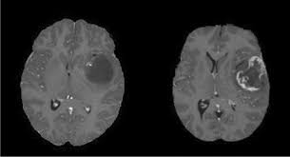
Architecture Diagram
Data Collection and Analysis
Model Development
Sampling
MRI scan images of
HUMAN BRAIN
CNN Architecture
Train Data
Test Data
Model Evolution
Data Preprocessing
-Shuffle
-Resize
-Normalization
Accuracy
Sensity
Confusion Matrix

Slide 26
DataSet Description
Glioma Tumor
Meningioma Tumor
Pituitary Tumor
No Tumor (healthy brains)
The Brain Tumor Classification MRI dataset on Kaggle is a comprehensive collection of MRI images intended for the classification of brain tumors. It contains 7023 T1-weighted contrast-enhanced images categorized into four classes:
Glioma is a type of tumor that originates in the glial cells of the brain or spinal cord. Glial cells, also known as neuroglia, provide support and insulation for neurons, the primary cells responsible for transmitting signals in the nervous system. Gliomas are the most common type of brain tumor .
A meningioma is a typically benign, slow-growing tumor that develops from the meninges, the protective layers surrounding the brain and spinal cord. It can cause pressure-related symptoms but is usually non-cancerous.
A pituitary tumor is an abnormal growth in the pituitary gland, which regulates hormones. Most are benign (non-cancerous) adenomas. Symptoms include hormone imbalances, vision problems, headaches, and fatigue. Treatment often involves surgery, radiation, or medication.
A healthy and Normal brain.
https://www.kaggle.com/datasets/masoudnickparvar/brain-tumor-mri-dataset

Slide 27
Final Result
Accuracy of Disease by Class
Class | Precision | Recall | F1-Score
Class 0(Glioma) | 0.99 | 0.97 | 0.98
Class 1 (meningioma) | 0.96 | 0.99 | 0.97
Class 2 (notumor) | 1.0 | 1.0 | 1.0
Class 3(pituitary) | 1.0 | 0.99 | 0.99
Model Accuracy
Model | Accuracy | Precision | Recall | F1-Score
Xception | 98.78% | 0.99 | 0.99 | 0.99
MobileNet V2 | 93.60% | 0.97 | 0.94 | 0.95
Inception V3 | 90.40% | 0.94 | 0.91 | 0.92

Slide 28
Status of work to be completed (Timeline)
Task | By Date
Review 0 With Guide | 31-07-2024
Review 1 with PPT | 28-08-2024
Implementation of project 60% | 14-10-2024
Review 2 | 23-10-2024
Draft paper for plagiarism check | 10-11-2024
Project Final (100 % implementation) | 25-11-2024
Thesis Verification | 26-11-2024
Final Review | 27-11-2024

Slide 29

Guide Approval Mail

Slide 30
References
Saeedi, S., Rezayi, S., Keshavarz, H., & R. Niakan Kalhori, S. (2023). MRI-based brain tumor detection using convolutional deep learning methods and chosen machine learning techniques. BMC Medical Informatics and Decision Making, 23(1), 16.
Liu, X., Bonner, E. R., Jiang, Z., Roth, H. R., Anwar, S. M., Packer, R. J., ... & Linguraru, M. G. (2023, April). Automatic segmentation of rare pediatric brain tumors using knowledge transfer from adult data. In 2023 IEEE 20th International Symposium on Biomedical Imaging (ISBI) (pp. 1-4). IEEE.
Soomro, T. A., Zheng, L., Afifi, A. J., Ali, A., Soomro, S., Yin, M., & Gao, J. (2022). Image segmentation for MR brain tumor detection using machine learning: a review. IEEE Reviews in Biomedical Engineering, 16, 70-90.
Shah, H. A., Saeed, F., Yun, S., Park, J. H., Paul, A., & Kang, J. M. (2022). A robust approach for brain tumor detection in magnetic resonance images using finetuned efficientnet. Ieee Access, 10, 65426-65438.
Ahmad, S., & Choudhury, P. K. (2022). On the performance of deep transfer learning networks for brain tumor detection using MR images. IEEE Access, 10, 59099-59114.
Bibi, N., Wahid, F., Ali, S., Ma, Y., Abbasi, I. A., & Alkhayyat, A. (2024). A Transfer Learning based approach for Brain Tumor Classification. IEEE Access.
Rajendran, S., Rajagopal, S. K., Thanarajan, T., Shankar, K., Kumar, S., Alsubaie, N. M., ... & Mostafa, S. M. (2023). Automated segmentation of brain tumor MRI images using deep learning. IEEE Access, 11, 64758-64768.
Subramanian, M., Cho, J., Sathishkumar, V. E., & Naren, O. S. (2023). Multiple types of cancer classification using CT/MRI images based on learning without forgetting powered deep learning models. IEEE Access, 11, 10336-10354.
Shukla, G. P., Kumar, S., Pandey, S. K., Agarwal, R., Varshney, N., & Kumar, A. (2023). Diagnosis and detection of Alzheimer's disease using learning algorithm. Big Data Mining and Analytics, 6(4), 504-512.

Slide 31
References
Khan, P., Kader, M. F., Islam, S. R., Rahman, A. B., Kamal, M. S., Toha, M. U., & Kwak, K. S. (2021). Machine learning and deep learning approaches for brain disease diagnosis: principles and recent advances. Ieee Access, 9, 37622-37655.
Pries, T. P., Jahan, R., & Suman, P. (2018, September). Review of brain tumor segmentation, detection and classification algorithms in fmri images. In 2018 International Conference on Computational and Characterization Techniques in Engineering & Sciences (CCTES) (pp. 300-303). IEEE.
Ezhilarasi, R., & Varalakshmi, P. (2018, August). Tumor detection in the brain using faster R-CNN. In 2018 2nd International Conference on I-SMAC (IoT in Social, Mobile, Analytics and Cloud)(I-SMAC) I-SMAC (IoT in Social, Mobile, Analytics and Cloud)(I-SMAC), 2018 2nd International Conference on (pp. 388-392). IEEE.
Jagannadham, S. L., Nadh, K. L., & Sireesha, M. (2021, November). Brain tumour detection using cnn. In 2021 Fifth International Conference on I-SMAC (IoT in Social, Mobile, Analytics and Cloud)(I-SMAC) (pp. 734-739). IEEE
Sakib, A., Khan, N. J., Shahrier, L., Plabon, K., Al Mahmud, J., & Mridha, M. F. (2023, December). Brain Tumor Detection and Classification Using Hybrid VGG Network. In 2023 26th International Conference on Computer and Information Technology (ICCIT) (pp. 1-6). IEEE.
Indra, Z., Jusman, Y., & Kurniawan, R. (2023, August). Development of Deep Learning Model Base on Modified CNN Architectures for Brain Tumours Early Diagnosis. In 2023 3rd International Conference on Electronic and Electrical Engineering and Intelligent System (ICE3IS) (pp. 503-507). IEEE.
Dipu, N. M., Shohan, S. A., & Salam, K. M. A. (2021, June). Deep learning based brain tumor detection and classification. In 2021 International conference on intelligent technologies (CONIT) (pp. 1-6). IEEE.
Koshti, S., Degaonkar, V., Modi, I., Srivastava, I., Panambor, J., & Jagtap, A. (2022, December). Brain Tumor Detection System using Convolutional Neural Network. In 2022 IEEE Pune Section International Conference (PuneCon) (pp. 1-6). IEEE.
Bhanothu, Y., Kamalakannan, A., & Rajamanickam, G. (2020, March). Detection and classification of brain tumor in MRI images using deep convolutional network. In 2020 6th international conference on advanced computing and communication systems (ICACCS) (pp. 248-252). IEEE.

Slide 32
Thank You
Do you have any questions?

